Slide 1


Industry Forum 2026:
Listening to Industry, Investing for the Future

Slide 2



Tasmania – Construction Industry
March 2026
2

Slide 3

Jobs and Skills Councils
Jobs and Skills Councils (JSCs) are a national network of industry owned and led organisations, designed to provide leadership in addressing national skills and training needs. They supply industry with a strategic voice in the VET sector.
We are the national JSC for the construction, property, and water industries. We provide:
A stronger, more strategic voice for the industry.
A vehicle for stakeholder groups to better understand and address their workforce and skills needs.
A responsive and systematic process for reviewing and updating training packages.
Notes:
Purpose: We work with the Building, Construction, Property and Water Sectors –
We work with Employers, Industry Associations, Registered Training Providers (RTO’s) and Unions to work in partnership with governments,
within the education and training system to ensure industry has a stronger voice, and to improve VET sector outcomes.

Slide 4
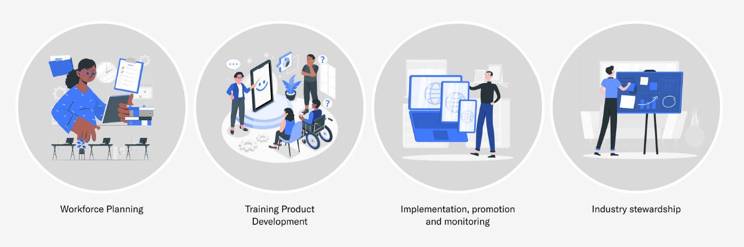
JSC core functions
JSCs bring together employers, unions and governments in a tripartite arrangement to find solutions to skills and workforce challenges. They have been established to provide industry with a stronger voice to ensure Australia’s vocational education and training (VET) sector delivers better outcomes for learners and employers across the following four core functions:
Notes:
JSC Core Functions – BuildSkills’ Four Pillars
Workforce Planning
We identify current and future workforce needs across the construction, property, civil and water sectors—so training matches real demand.
Training Product Development
We maintain and update nationally recognised qualifications and units to reflect how work is actually done on the ground.
Implementation, Promotion & Monitoring
We support awareness and uptake of training products, track how they’re being used, and report on what's working.
Industry Stewardship
This is our big-picture role—providing objective, industry-led advice to ensure the VET system delivers real outcomes for learners, employers and the economy.

Slide 5



Our world
Construction
Builders – both residential and commercial
Heavy and civil contractors
Subcontractors, excluding electrical and HVAC
Consultants – architectural, engineering and technical
Plant and equipment hire
Property Services
Real estate agency and property management
Cleaners and pest control
Investigation and security
Waste collection, treatment and disposal
Water Services
Water supply, sewerage and drainage
Notes:
High-Level Overview – Our Sector Scope
Construction: Everything that gets built, from homes and high-rises to roads and bridges, except for electrical and mechanical trades. This includes both general construction and civil construction activities.
Property Services: Every property that gets managed in some form, real estate, facilities management, security, cleaning, pest control, and strata services.
Water Industry: Covers the full cycle of water and wastewater collection, treatment, storage, and distribution. Essentially, every fluid entering or exiting a built structure.

Slide 6

Long-term trends

Slide 7
Net zero challenge keeps getting bigger
Renewables share of on-grid electricity generation
2030 target
Current trajectory
Source: Climate Change Authority
Notes:
The drive toward net zero emissions remains a dominant force shaping the future of workforce demand across the construction industry.
The past year has seen continued expansion in renewable energy infrastructure and transmission networks, but progress has slowed.
According to the Climate Change Authority’s Annual Progress Report, the current pace of deployment is insufficient to meet the Australian Government’s target of 82% renewable electricity generation by 2030.

Slide 8
The housing challenge is also huge
Residential construction labour demand projections, 2029
Source: Oxford Economics for BuildSkills Australia
Notes:
The National Housing Accord sets an explicit ambition of delivering 1.2 million new homes by mid-2029
A significant workforce mobilisation will be needed if the Accord target is to be met.
We estimate that the level of construction activity consistent with achieving the target will demand a significant increase in the number of residential construction workers, in the order of 116,700 workers.

Slide 9
We’re running out of workers
Population growth, Australia
Dependants
Working age population
Source: ABS, BuildSkills
Notes: Data indexed (2024=100). ‘Working age population’ = persons aged 15-64; ‘Dependants’ = the rest.
Notes:
The ageing population is another trend reshaping Australia, leading to a decreasing proportion of people within prime working age groups.
In the 1980s, approximately one-quarter of Australia's labour force was aged 45 years or older; today, nearly 40% of workers fall into this age bracket.
This is projected to emerge as a critical workforce bottleneck in the coming years. Construction firms will increasingly need to attract a larger share of this young male demographic simply to sustain current workforce levels.

Slide 10

Skilling system capacity
Skilling system
Workers
Notes:
Another important aspect is the capacity of the skilling system to respond to shifts in labour demand.
RTOs are struggling to recruit skilled trainers and workplace supervisors.
BSA interviewed nearly 200 RTOs delivering training to our industries. Almost half were recruiting, which is broadly consistent with the wider economy.
However, two-thirds of those recruiting reported significant difficulty filling vacancies, more than 30 per cent higher than the broader labour market.
The bottleneck is not demand for training.
It is the supply of trainers.

Slide 11
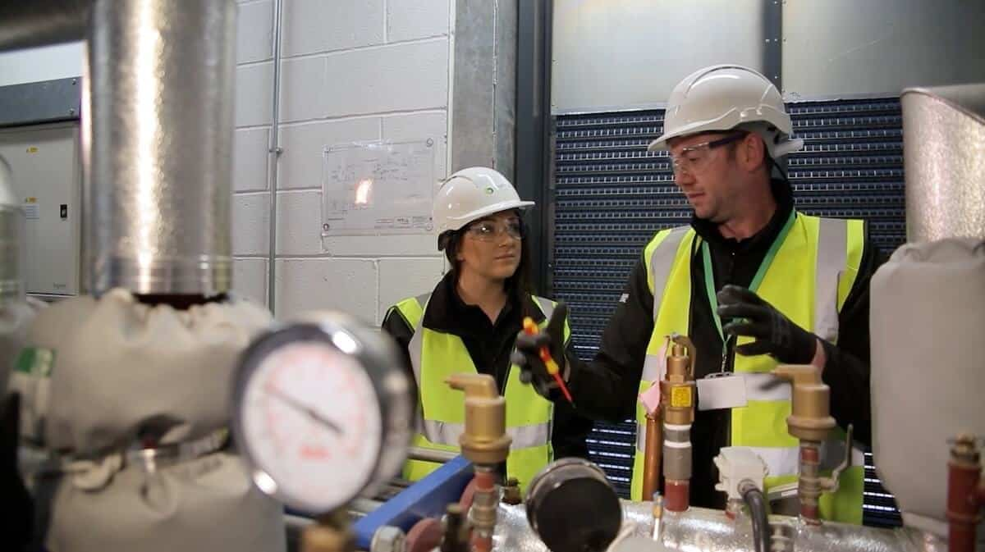
State Overview

Slide 12
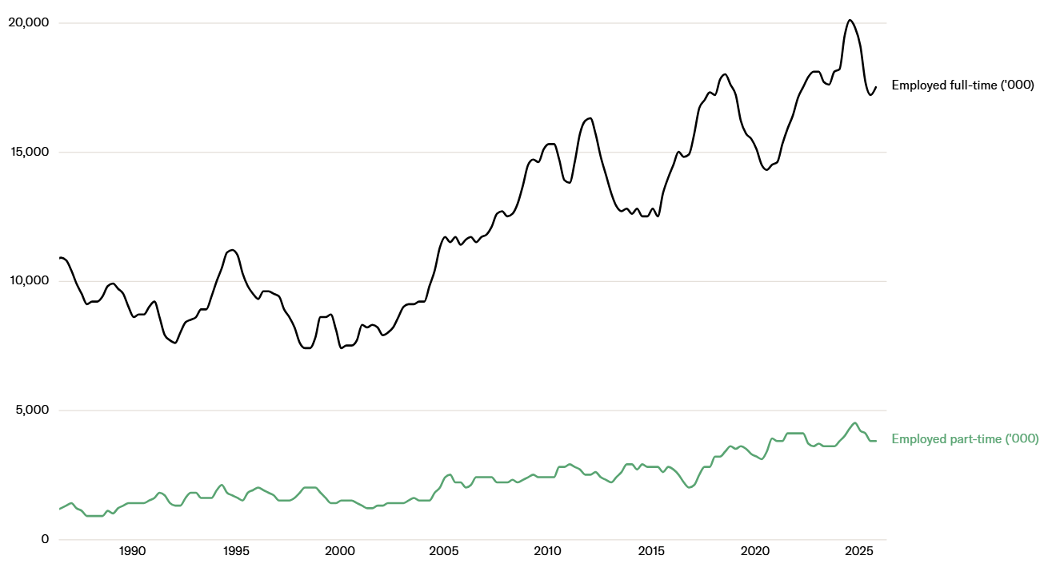
Employment has risen sharply
Employment, Construction Industry, Tasmania
Source: ABS (2025), BuildSkills Australia
Notes:
Construction industry employment has increased substantially over the long run.
The dominant driver of that growth has been full-time roles. While, most of the recent expansion in the workforce has come from full-time employment. We have seen a gradual increase in part-time employment.
We’ve also seen increased volatility over the past decade, reflecting Tasmania’s market size. When you have a smaller labour pool, the timing of major projects can have an outsized impact on employment numbers — both on the way up and on the way down.

Slide 13
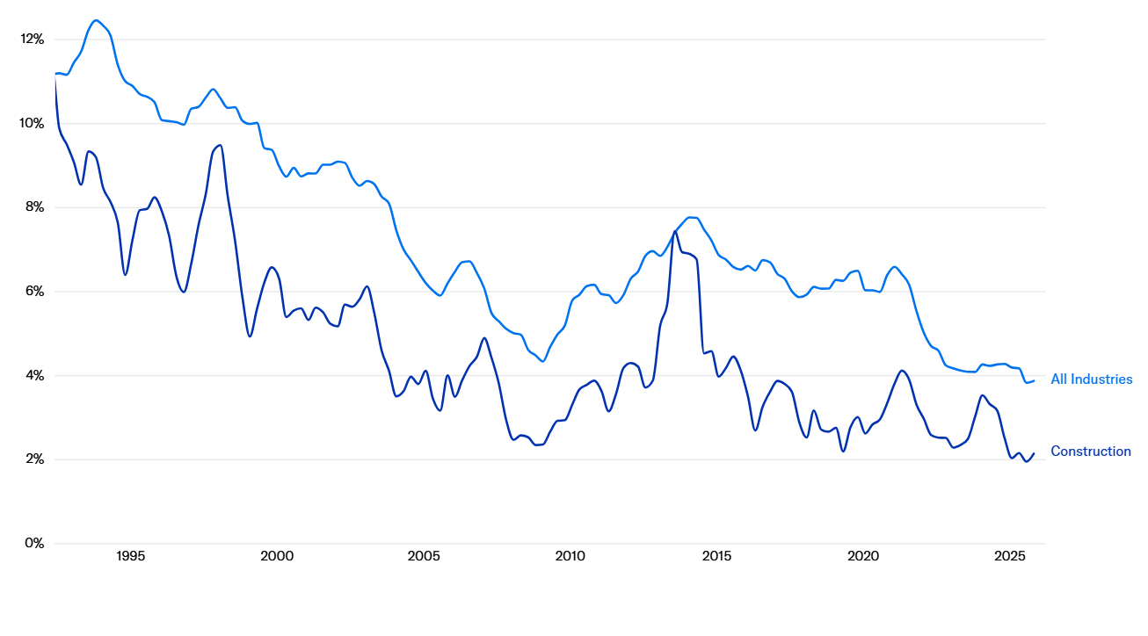
Unemployment has fallen to structurally low levels
Unemployment rate, Construction Industry, Tasmania
Source: ABS (2025), BuildSkills Australia
Notes:
Industry unemployment has declined over the past few decades.
In the 1990s, unemployment in the sector was in double digits. Over time, that has trended decisively downward to very low levels in recent years.
Importantly, construction unemployment has consistently tracked below the all-industries average. That tells us the construction labour market has been tighter than the broader Tasmanian economy for a sustained period.
Note: The unemployment rates shown are calculated as the ratio of unemployed persons whose last job was in the relevant industry to the sum of this number and the total number of employed persons in that industry. Values represent a weighted average across the relevant industries. They indicate the estimated sector trend rather than actual observed rates.

Slide 14
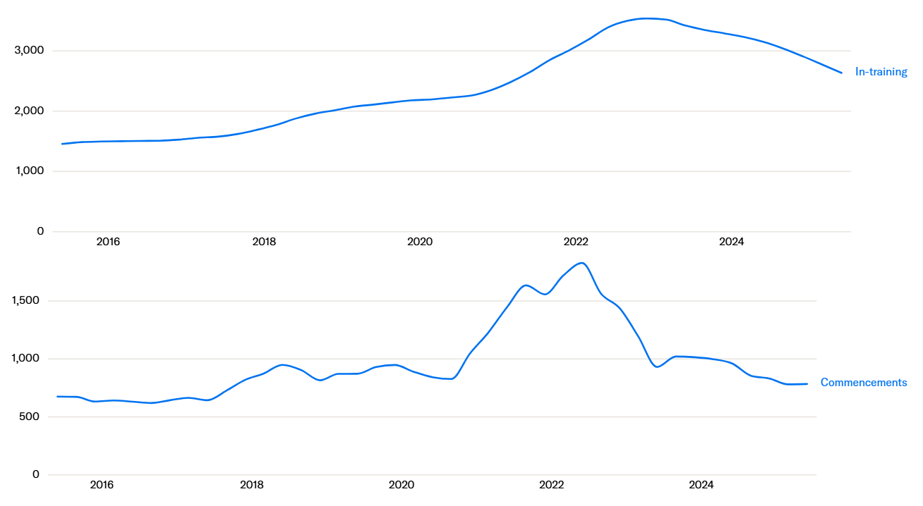
Training activity remains elevated
Training pipeline, Construction Industry, Tasmania
Source: NCVER A&T (Jun 2025), NCVER (2025)
Notes:
We saw a very significant uplift in apprentice and trainee commencements during the COVID period, driven by government incentive programs.
As this cohort is working their way through the system, we’ve continued to see higher numbers of apprentices and trainees in-training.
However, we are now seeing that activity begin to normalize and both commencements and overall in-training numbers are trending back toward their historical averages.
Note: Apprenticeships & Traineeships Commenced (latest quarter, 4 quarters total), In-training (latest quarter, 4-quarter average)

Slide 15
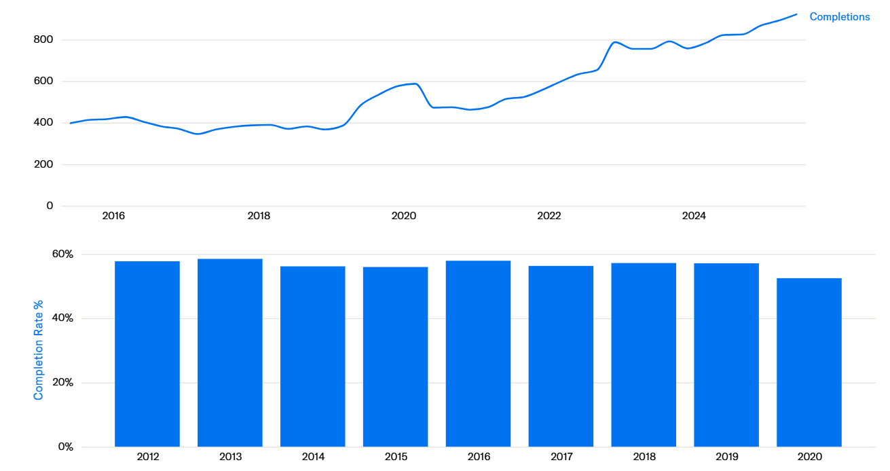
Strong increase in completions
Training pipeline, Construction Industry, Tasmania
Source: NCVER A&T (Jun 2025), NCVER (2025)
Notes:
Completions have increased over time, which is positive. But the growth has been gradual and will begin to decline in line with the fall in commencement numbers.
Completion rates have been relatively steady from 2012, with a slight decline in recent years. This matters because enrolments alone do not translate into workforce supply. What ultimately counts is completions.

Slide 16
Training activity is concentrated in a narrow set of qualifications
In-training by top 10 qualifications, Construction Industry, Tasmania
Source: NCVER (2025)
Notes:
The graph shows the top 10 construction apprentice and trainee qualifications.
Training activity is highly concentrated in a small number of Certificate III trade qualifications, with carpentry accounting for a large share of all learners over the decade to 2025.
Note: In-training data is the average number of apprentices and trainees in-training over the 12 months to Jun 2025

Slide 17
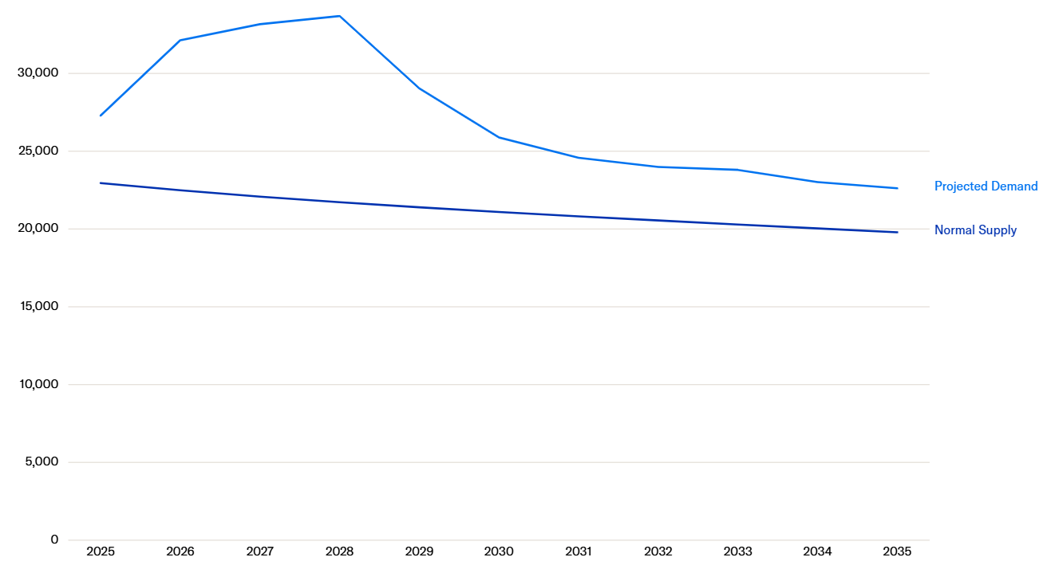
The workforce challenge
Normal labour supply and projected demand, Construction Industry, Tasmania
Source: Oxford Economics for BuildSkills Australia.
Notes:
Projected demand, reflects a scenario where the policy objectives of government including the national housing accord are fully realised.
The gap between normal supply and projected demand indicates that recent trends in workforce supply are unlikely to meet future needs.
This gap represents the additional labour that must be mobilised to support projected activity. This could be through increased participation, higher apprentice completions, targeted skilled migration, or productivity gains.
Bridging this gap can be achieved through a combination of natural market adjustments and deliberate policy intervention.
Notes: Projected demand – includes policy ambitions (listed below) as well as an explicit list of projects that Oxford Economics tracks.
Implicitly included
National Housing Accord
Greening the grid
Future Made in Australia
Green hydrogen and electric vehicle uptake
Note: "Projected demand" reflects a scenario where the objectives associated with the megatrends assessed in BuildSkills' 2025 Workforce Plan are fully realised. "Normal supply" is a business-as-usual forecast of labour supply that reflects existing trends and reasonable demographic forecasts.
Construction Industry (ANZSIC 30, 31, 32)

Slide 18
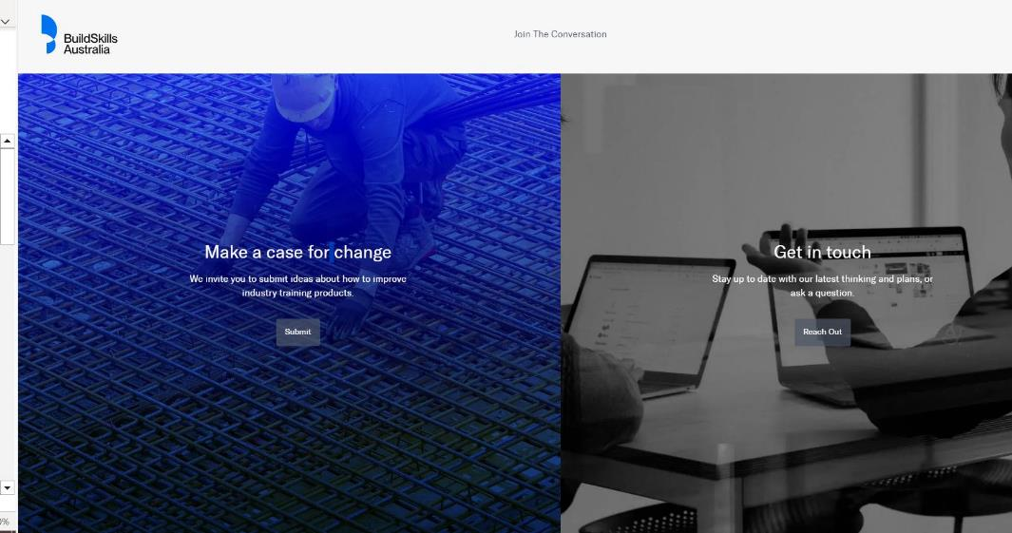
Engaging with BuildSkills Australia
Make a case for change
Check out our Events
Follow us on LinkedIn
State & National Managers, Industry Engagement
Notes:
▪ Make a Case for Change
Anyone in industry can submit a proposal to update qualifications or units through our “Case for Change” process.
This is your opportunity to flag emerging skills gaps, training issues, or licensing misalignment.
Submissions help us prioritise national training product reviews and shape future workforce development.
▪ Check out our Events
BuildSkills hosts workshops, roundtables, and forums across the country—designed to capture real industry input.
These events provide direct access to our project teams and are a valuable way to influence reform.
Keep an eye on the Events page for updates and registrations.
▪ Follow us on LinkedIn
Stay informed on training updates, workforce insights, and national project milestones.
We share opportunities to engage, new research, and consultation highlights.
Just search “BuildSkills Australia” on LinkedIn and follow our page.
▪ State & National Managers, Industry Engagement
Each state and training package area has a dedicated BuildSkills representative.
We’re your direct link into the Jobs and Skills Council process—bringing your views back to our project, research, and policy teams.
Reach out anytime—we're here to help you navigate changes and get your voice heard.

Slide 19
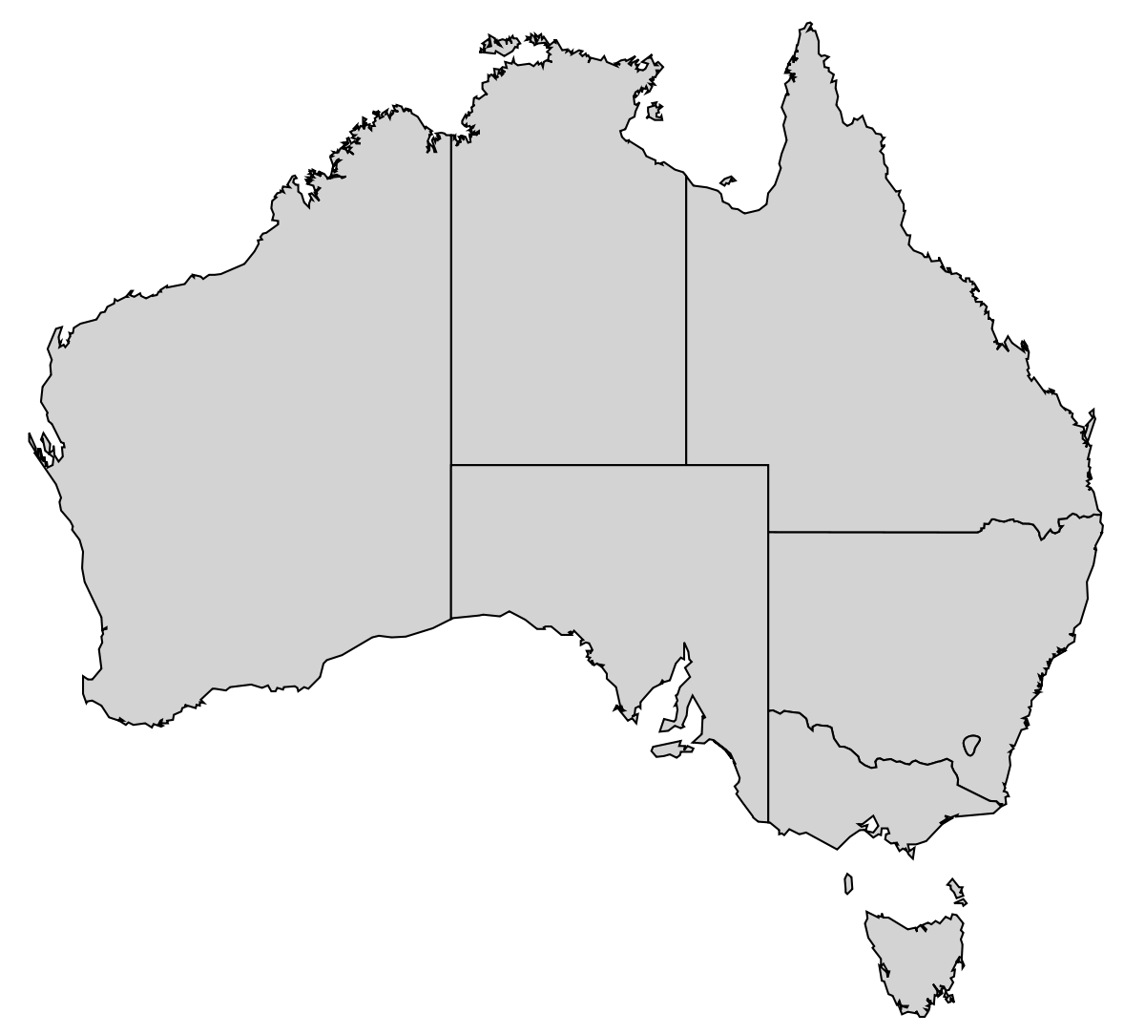







Industry Engagement Team
(National Manager Water Sector)
Paul Muenchow
(National Manager Property Sector)
Anthony Chan
(General Manager,
Service Delivery)
Hayden Eberle
(SA/NT State Manager)
Adam Pringle
(QLD State Manager)
David Cameron
(Industry Engagement Lead - Water)
Amanda Hamilton
(WA State Manager)
Jess Ruffy
(Service Delivery
Coordinator)
Hayden Eberle
(SA/NT State Manager)
Tony Vitler
(NSW/ACT State Manager)
Building and Construction (Commercial and Residential)
Ingrid Mountford (VIC/TAS State Manager)
Civil Construction
Notes:
significant investment in building a strong network of industry engagement across the country
experienced state managers, located strategically nationwide, are dedicated to providing a direct and accessible channel for industry to engage with us
sector-specific expertise
offer tailored support and ensure that the industry's voice is heard at the highest levels

Slide 20


Thank you
www.buildskills.com.au
buildskills-australia

Slide 21

Building for the Future
What's Next for Tassie's Construction Workforce?

Slide 22
Our Industry in Numbers (ABS Data)
Size of Tasmanian Construction
Businesses
(2025)– 7,126 businesses
Employment
27,693
People
Employed in
Tasmanian
Construction
10%
Of total employment
in Tasmania
(range 6.8-10.5% in last 20 years)
*Source: ABS 6291 Labour Force; 8165 Counts of Australian Businesses

Slide 23


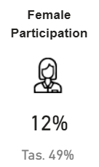


What do we know about the workforce?
High prevalence of VET qualifications (59% compared to 37% across all Tas workforce)
Only 12% of the workforce are female
Employment growth projection (2024-27) at 2.8%
Compared to
Healthcare & Social Assistance: 8.3%
+ employs almost twice as many people
Electricity, Gas, Water & Waste: 6.1%
Mining 5.4%
Accommodation & Food: 4.1%
Retail Trade: 1.3%
Manufacturing: 1.0%
See Note (1)
Almost a third of workers have no Post-School qualification (about the same as the general population)
A relatively young sector… About a quarter are over 50, compared to more than a third across all industries
Source: Skills Tasmania Labour force projection tool. Note (1) conservative growth projection based on economic modelling and Treasury data, not referencing potential major projects

Slide 24






136 responses
60% from smaller employers
What You Told Us
2026 Keystone Training Needs Survey
What are the top skills your workforce needs to improve in the next 12 months?
Safety, regulatory compliance
New construction code, training required for licences, traffic management, high risk work
Technical Trade Skills
Short courses or longer qualifications essential for quality work in construction
Leadership & Supervision
First time supervisors, leadership and culture to support workforce retention
01
02
03
Project / contract management
Construction contracts, estimating
Communication & Teamwork
Working together in a team
Using technology and digital tools
AI, BIM, CAD, Drones and other tech
04
05
06
Source: Keystone Tasmania 2026 Training Needs Survey Results

Slide 25
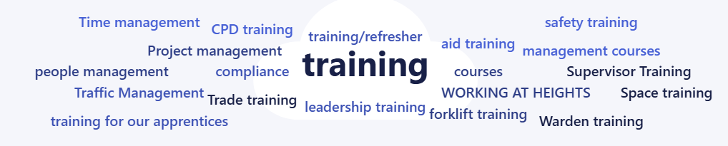
What specific training do your employees need in the next 12 months?
Main requirements for training:
Safety compliance refreshers: First Aid, Working at Heights, Silica awareness, electrical safety
High risk licences and plant tickets: forklift, boom / scissor lift, rigging & dogging, heavy vehicle licencing, traffic management, excavator, diggers
Building code / NCC and regulatory change: how to keep up, real life case examples, CPD points, interpretation + applied guidance
Trade-specific upskilling: especially waterproofing + HVAC electrical, electrical upskill, solar
Leadership, supervision & tradie to leader people skills: incl communication, conflict resolution
Digital capability & business operations

Slide 26
Where the Training Money is Going Now (Keystone Data)
As at 31 January, we had invested $910K in training rebates
Breakdown of Cert IV:
Cert IV Building & Construction – 17%
Cert IV Plumbing & Services – 13%
Other Cert IVs – 2%
Source: Keystone Tasmania

Slide 27
Have Your Say
Help us plan for the future.

Slide 28
Workshop: Exploring the future skill needs of Tasmania’s building and construction industry
Categories
    Safety, regulatory compliance
    Technical trade skills
    Leadership and supervision
    Mental Health
    Project / contract management
    Communication and teamwork
    Using technology and digital tools (including AI, BIM, CAD, drones)
    Sustainability and green building practices, clean energy
    Gearing up for major projects

Slide 29


Workshop: Exploring the future skill needs of Tasmania’s building and construction industry
On your table, answer these questions for your category:
What does success look like if we get this right?
  What do we see / hear?
  What numbers could we report on?
  How do we know we’re succeeding?
What are the key challenges in this area?
  Any emerging opportunities or threats?
  Are there enough quality training providers?
  Are the courses right?
  Are employers focused on this?
What needs to be included?
  What’s most important for Keystone to fund? (specific courses, projects, activity?)
  What’s the responsibility of employers?
  What else is needed here?
5 mins on your current table, then move

Slide 30

Online: Join the padlet
https://padlet.com/KeystoneAdmin/keystone-tasmania-2026-industry-forum-j2lfl0wee1rsogpg

Slide 31
Thanks & What's Next?

